Slide 1
Search for potential value and for structure of city creating new value in Sakai city
Hamabe・Hara・Kaneko・Nakao・Namba・Ootsuka・Takahashi・Ueda・Uemoto

Slide 2
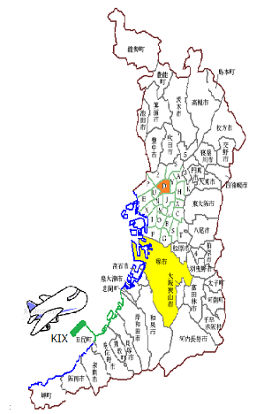
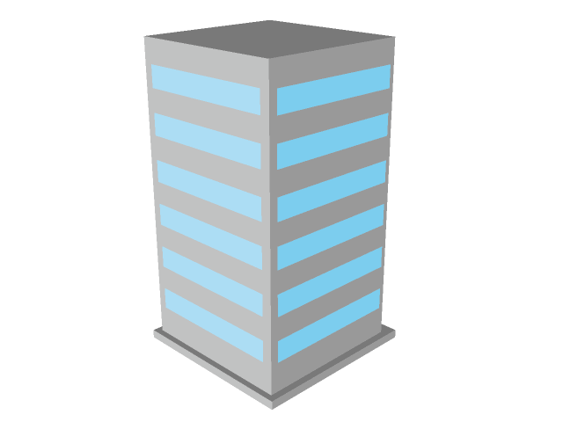
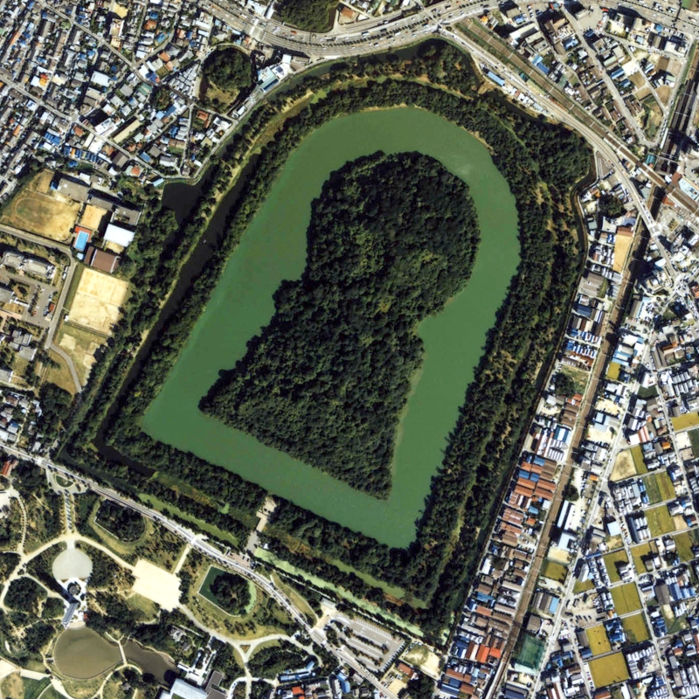
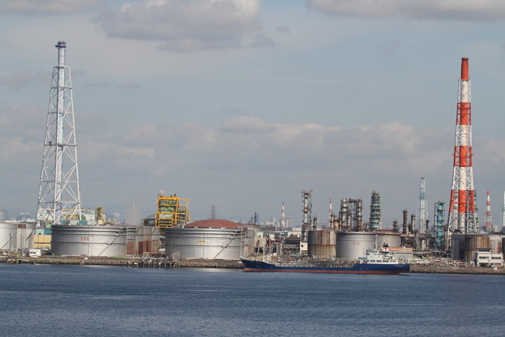
About Sakai city
150 km² in area
Population : about 850 thousands
Ancient burial mound
Industrial area
Umeda
30min.
Sakai city
30min.
Notes:
大阪府堺市は大阪府の泉北地域に位置する面積 、人口約85万人を誇る政令指定都市
梅田や関西空港から約30分
市内には多数の古墳が存在し日本の中心だったことが伺える。中世は自由都市として堺商人や鉄砲鍛冶が活躍
現代では刃物や自転車、昆布など伝統産業が依然として高いブランド力を維持する他、臨海地域という特性を生かし、工業都市として幅広い産業を行い特に金属製品製造業や生産用機械器具製造業などの割合が多い。

Slide 3
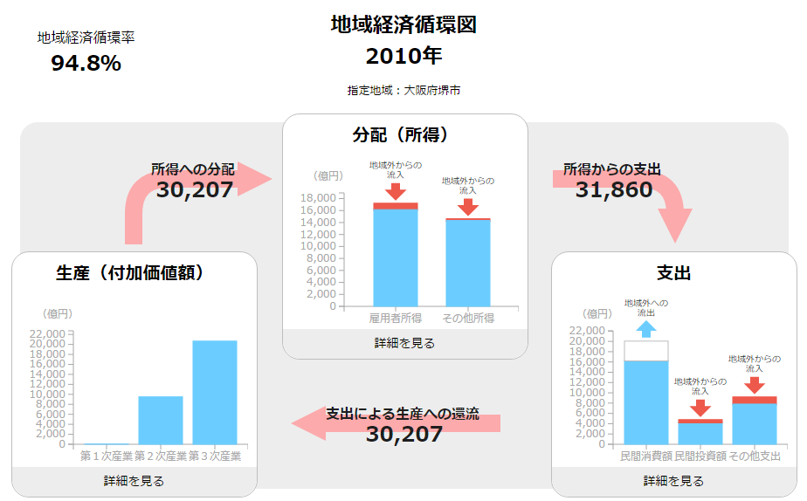
Financial flow map
of sakai city
In 2010
Rate of financial flow
income
expenditure
added value

Slide 4
Rate of financial flow
Rate of financial flow = added value÷ income
financial self-supported degree is shown
→the less value shows the higher dependence on the income from another city
e.g.
Tokyo：151.8%
→outflow of income and inflow of consumption are high
Kyoto city：100.6%
→added value ≒ income
Sakai city： 94.8%

Slide 5
Added value ＝gross output－ Intermediate input
Labor productivity
 | Primary sector | Secondary sector | Tertiary sector
Added value | 1,890,000 | 10,490,000 | 9,000,000
Ranking (/1741) | 1028 | 254 | 271

Slide 6
Income…allotment of added value
Compensation of employees
→was paid to employees
Others
→business income・local grant tax etc.
⇒The income distributed in the other areas flows here.
 | Employees’ | Others
Income(/person) | 4,760,000 | 1,740,000
Ranking(/1741) | 186 | 1268

Slide 7
支出流出入率」とは、地域内に支出された金額に対する地域外から流入・地域外に流出した金額の割合で、プラスの値は地域外からの流入、マイナスの値は地域外への流出を示す

Slide 8
Expenditure…Usage of the income
Private consumption
→consumption of citizen
Private investment
→business investment etc.
Others
→ government expenditure etc.
⇒Income is consumed
in other cities
 | Consumption | Investment | Others
支出流出入率 | -19.20% | 15.10% | 20.40%
Ranking (/1741) | 1343 | 210 | 264

Slide 9
Principle of equivalent of three aspects
Added value=Income=Expenditure
But…
Sakai city：Expenditure≦Added value≦Income

Slide 10
Income
①
the other area
Inflow
Added value
Expenditure
②
Outflow

Slide 11
①分配の流入

Slide 12
Issue of Sakai city ～Expenditure side～
Outflow⇒less of rate of financial flow
GDP=C+I+G+NX
※C=Private consumption
I =Private investment
G=Government expenditure
NX=Net export

